Slide 2
POSTSOVIET
CIVIL RELIGION
SERGEI CHAPNIN
www.chapnin.ru
MOSCOW 19 November 2015

Slide 3
COMMUNISM
as political religion
The theory of political religion concerns governmental ideologies whose cultural and political backing is so strong that they are said to attain power equivalent to those of a state religion, with which they often exhibit significant similarities in both theory and practice.

Slide 4
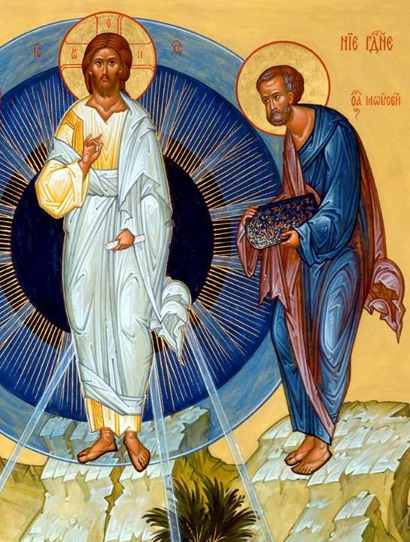
Do not be surprised.
This presentation I decided to start with the Orthodox Christian icon.
This is a traditional and widespread iconography of the Transfiguration of the Lord.
It’s main message is to depict the symbolic image of the Glory of God.
Let's analyze this message - what and how do we say this icon?

Slide 5
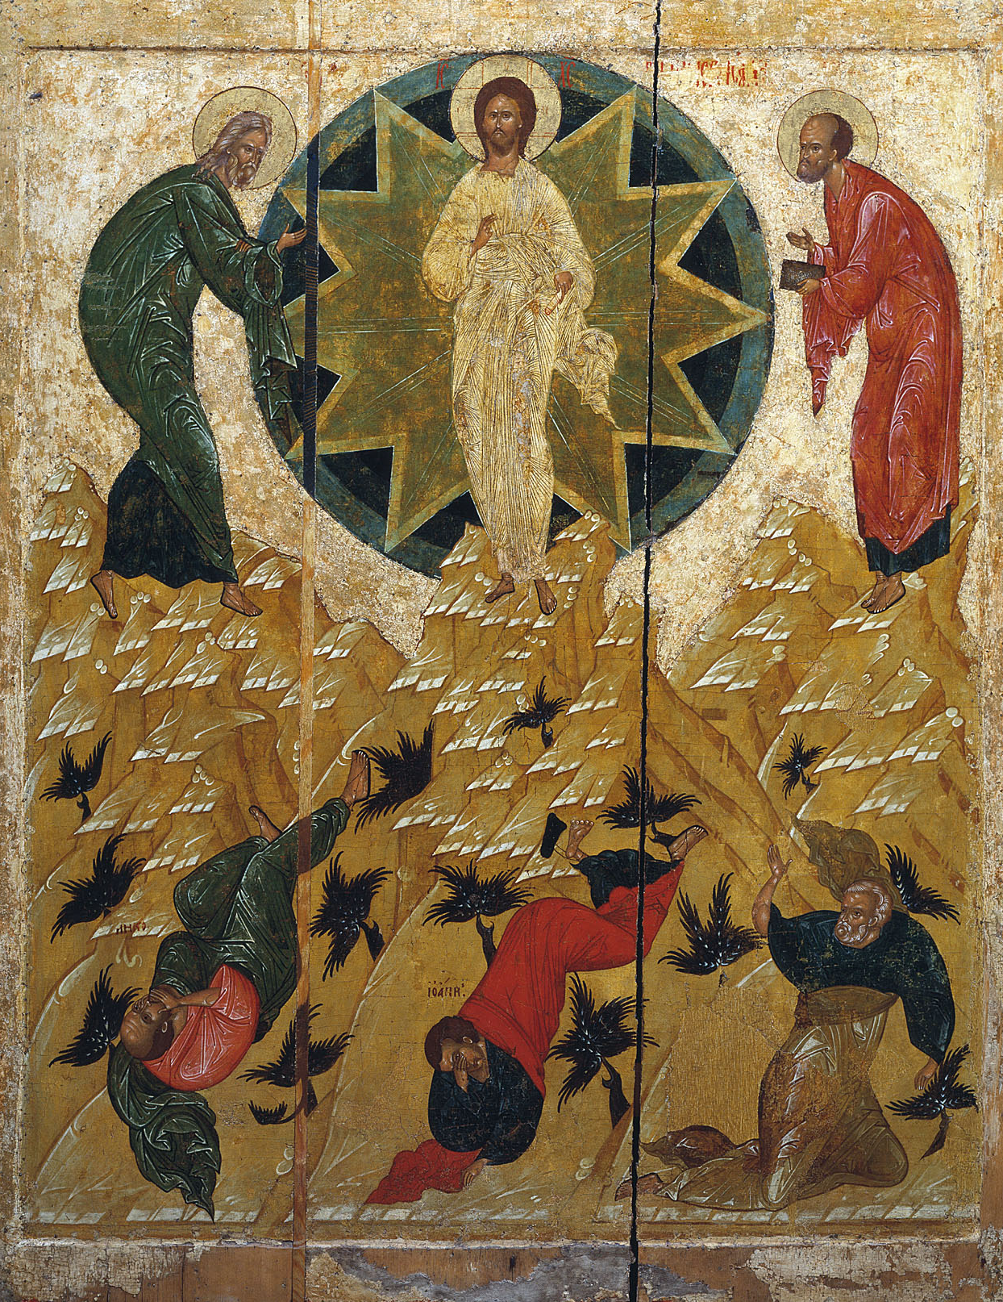
The icon exactly follows the Gospel.
Christ, standing on the hill (the symbol of ascension, the special spiritual state of separation from everyday life) is in a mandorla - in expanding circles of divine glory, He - the Sun of righteousness, the glory of the radiant rays diverge. In Christ’s hands we see of a scroll indicating His teaching - the Divine truth.

Slide 6
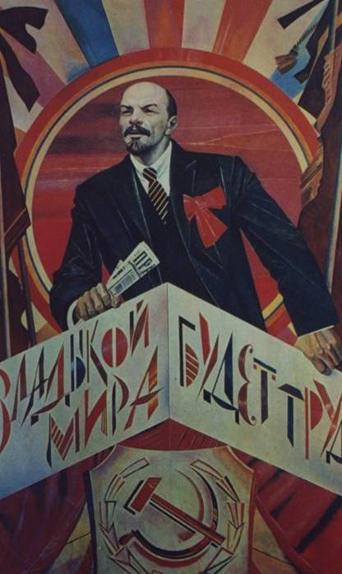
May be art will re-find its application, it will create new Raphaels, who will paint the corners of Lenin and turn them into temples.
The development of such a path would lead materialism to a new kind of religion. And its churchts will be decorated with the images of the new miracles of the modern history and stories about suffering of those, who fall asleep fighting with the capitalists.
(Malevich, 1924)

Slide 7
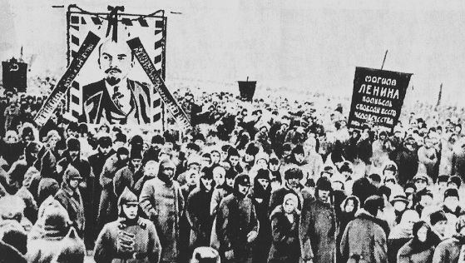
Funeral demonstration
1924 г.
Inscription on the banner: "Lenin's Tomb - the cradle of the freedom of mankind."

Slide 8
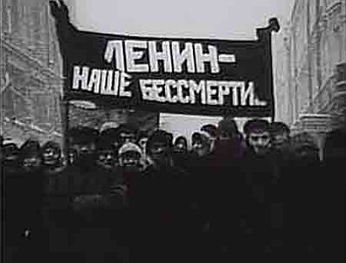
Funeral demonstration
1924 г.
And another poster with a more explicit religious content, "Lenin - our immortality." Here we see a direct reference to the Resurrection of Christ.
Stalin in funeral oration said: "In these days you have seen the pilgrimage of the hundreds of thousands of workers to the grave of Comrade Lenin. After a while, you will see the pilgrimage of representatives of millions of working people to Comrade Lenin's tomb. There is no doubt that the representatives of millions will come soon and then the representatives of tens and hundreds of millions from all over the world will witness that Lenin was the leader not only of the Russian proletariat, not only of the European workers, not only of the colonial East, but the whole working world globe“.

Slide 9
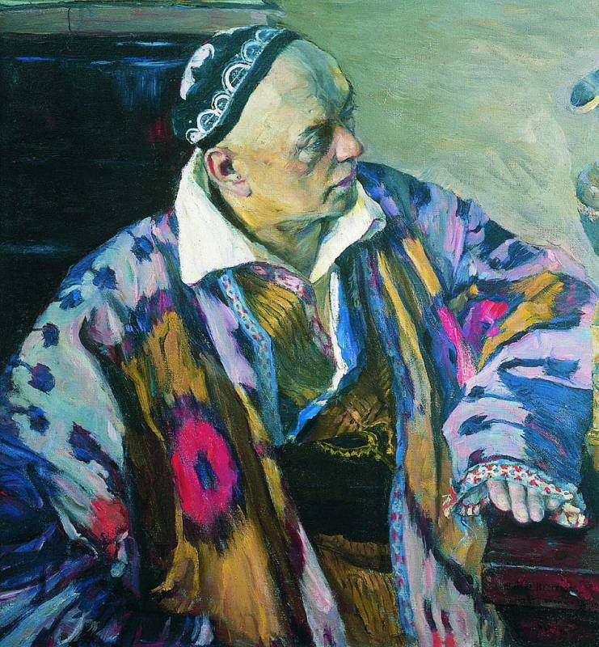
Alexey Shchusev from 1901 was the architect service in the Office of the Holy Synod. One of his first projects was the design of the iconostasis of the Assumption Cathedral of the Kiev-Pechersk Lavra, he designed churches in Sanremo and Bari, the Martha and Mary Convent in Moscow, church on the Kulikovo field and many others...
Alexey Shchusev, 1941

Slide 10
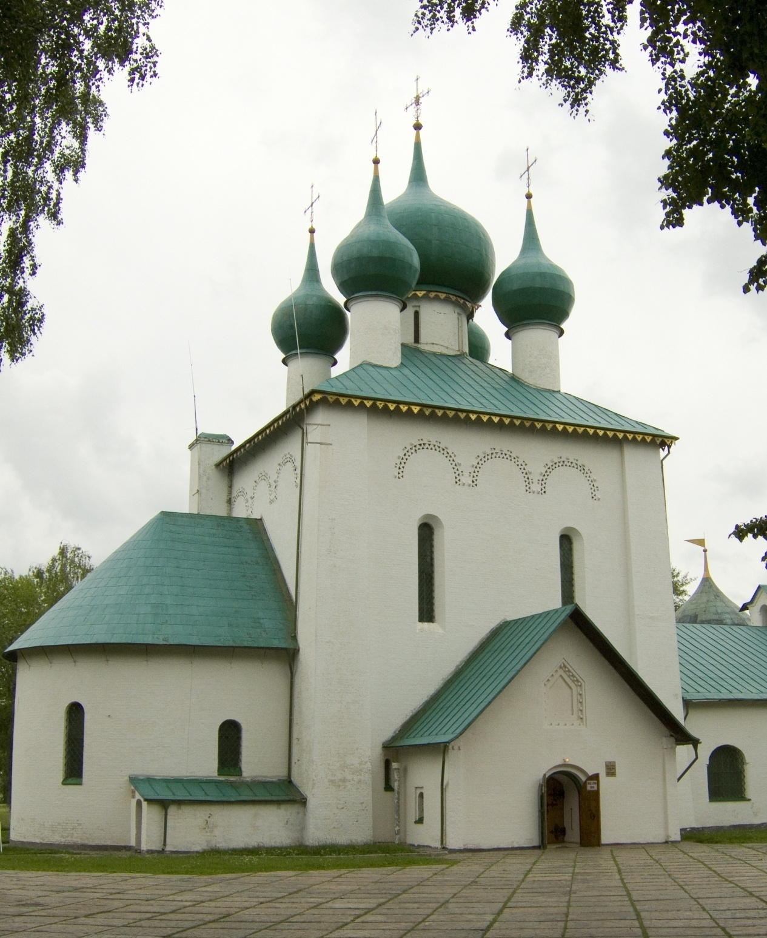
А. Щусев
Храм прп. Сергия Радонеского на Куликовом поле.

Slide 11
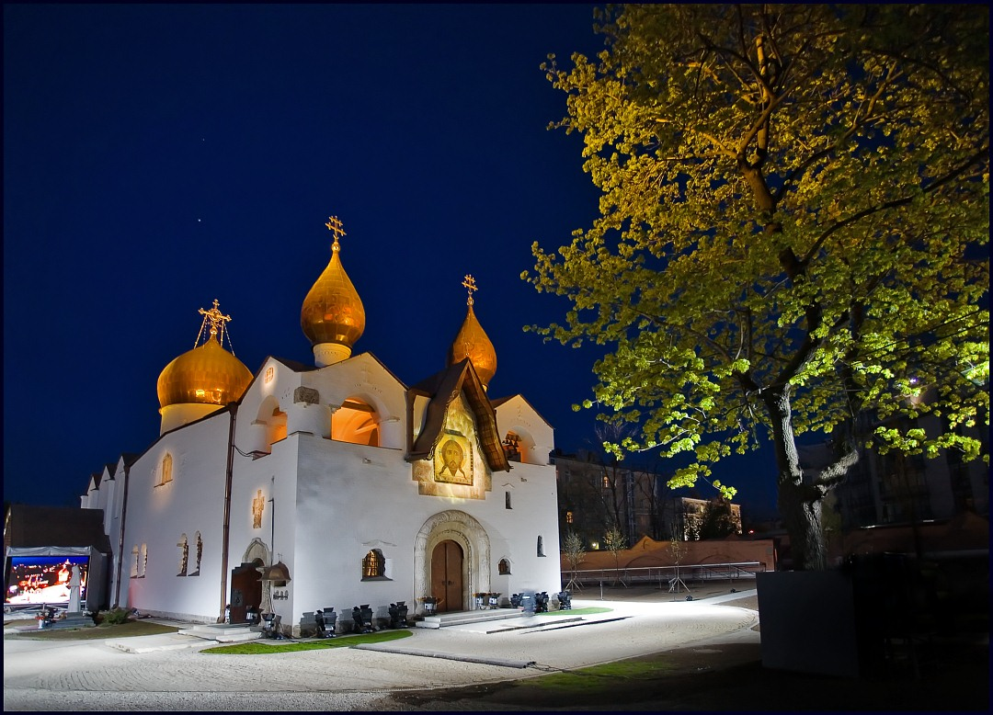
А.Щусев. Храм Покрова Пресвятой Богородицы в Марфо-Мариинской обители (1908-1912), Москва.

Slide 12
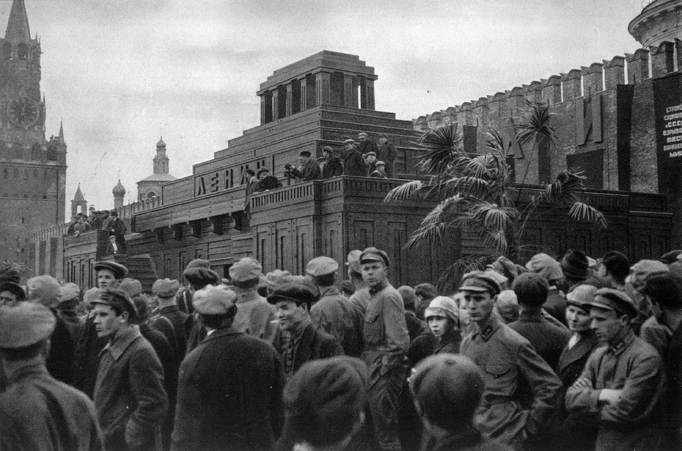
Так выглядел второй вариант мавзолея, возведенный весной 1924 г. по проекту архитектора А.В.Щусева.
...But he became a celebrity in 1920-s. His most famous project - the mausoleum of Lenin, the main sacred object of the godless Soviet power. For the interior of the third (stone) mausoleum, he received one of his four Stalin Prizes.

Slide 13
Postsoviet
Civil Religion

Slide 14
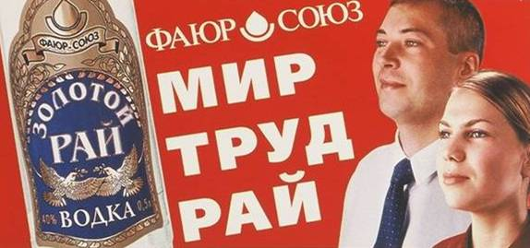
It all started innocently and even with some fun.
Advertising of vodka. The inscription on the advertising of "peace - work - Paradise" is a paraphrase of the well-known to every Soviet citizen triad "world - labor - May", which has been used for many years in the Soviet propaganda.

Slide 15
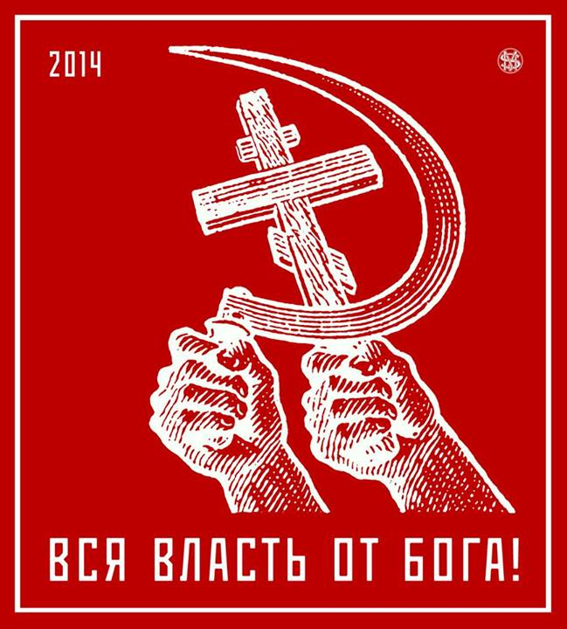

Slide 16
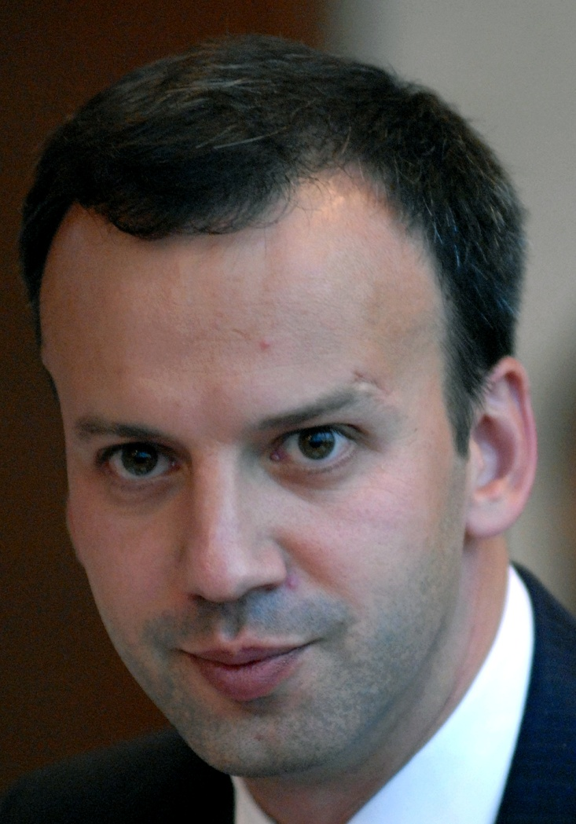
Признание молодого вице-премьера Правительства РФ
Аркадия Дворковича (1972 г.р.):
"They brought me to sign a draft decision of the government ... which abolished a number of other decisions of state authorities, including the decisions taken in 1918, 1920 and 1931, and I think in the 1935- m respectively, signed including Vladimir Ilyich Ulyanov-Lenin ", - said the official. These regulations were in long conflict with a number of state acts, but Dvorkovich admitted that he had "not raised a hand to approve this decision, and so far it works."
And then Deputy Prime Minister added the phrase, which can be considered a confession of personal faith, or at least a real manifestation of personal values, which are expressed in his public activities: "In general you can not undo anything that was signed by Lenin, is blasphemy, I believe.“
Государственное информационное агентство «РИА Новости»,
3 октября 2012

Slide 17
Blasphemy is the act of insulting or showing contempt or lack of reverence for (a) God(s), to religious or holy persons or sacred things, or toward something considered sacred or inviolable.
Some religions consider blasphemy as a religious crime.

Slide 18
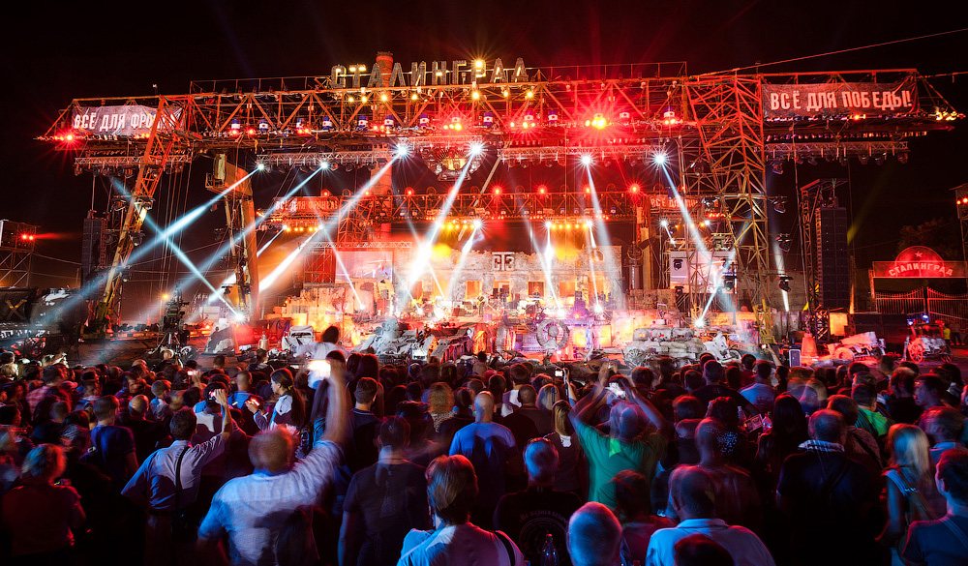
«Сталинград»,
байк-шоу к 70-летию победы в Сталинградской битве,
2013
Alexander Prokhanov, contemporary writer (August 2013):
I think I was in a giant, a grand church! Its domes go to heaven, to the stars, and there was even a silver moon there. And at the bottom of the temple took place the show - the interpretation of the events of the Battle of Stalingrad. Light conquers darkness. This blazing firecrackers, fireworks as divine light - all this symbolized the phantasmagoric battle of these two forces. It was the temple of Stalingrad. And this church has its congregation - there were 200 thousand young people who in one breath praying for everything that happened. And this action has a saint - his name was Joseph Stalin.

Slide 19
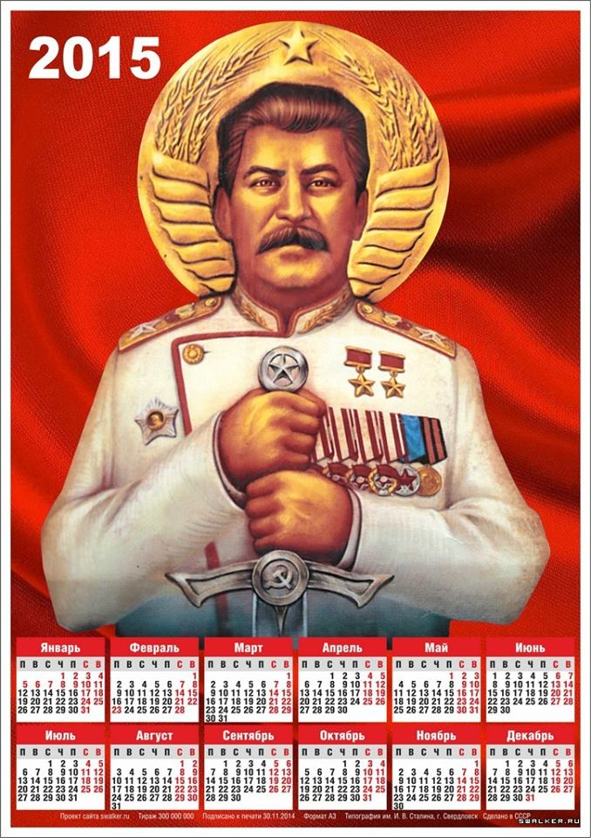
A page from calendar
A political religion often elevates its leaders to near-godlike status.
Collage explicitly refers to traditional Christian iconography.

Slide 20
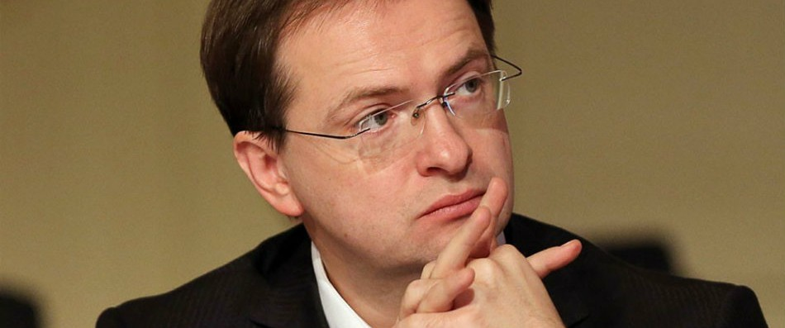
Vladimir Medinsky, the Minister of Culture of the Russian Federation (August 2015):
The epic Soviet heroes should be treated as the saints canonized by the church. This is my opinion as Russian citizen.
«Российская газета», август 2015

Slide 21
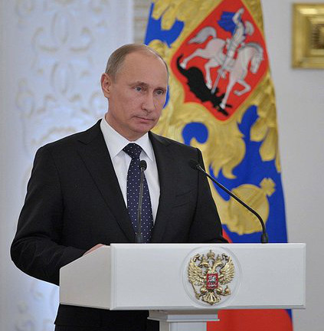
President Vladimir Putin:
Code of the Builder of Communism - what is this? It says the same thing in the Bible or in the Qur'an: Do not steal, do not kill, do not covet your neighbor's wife. It's all spelled out there, and from there taken. Here, many talk about the Mausoleum, say this is not the tradition. What is not in the tradition? Travel to Kiev-Pechersk Lavra, or see that in the Pskov Monastery on Mount Athos either. There are relics of the holy people.
…In this sense, the Communists, even in this part of the tradition intercepted. They do this correctly, in accordance with the needs of the time.
Стенограмма встречи В.В.Путина с доверенными лицами.
Кремль, 10 декабря 2012 года

Slide 22
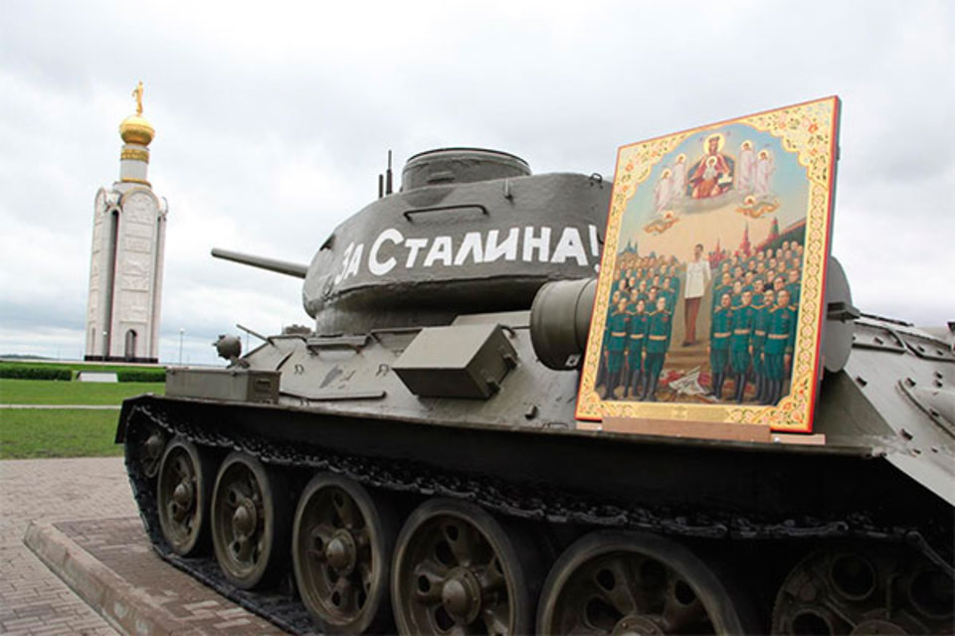
Alexander Prokhanov, contemporary writer (May 2015):
In my opinion, Stalin atone for his sin by winning the war. Victory - a ransom for all sin. And if, in your opinion, he is a sinner and do not atone for his own sins, then he would have had to be defeated this war.

Slide 23
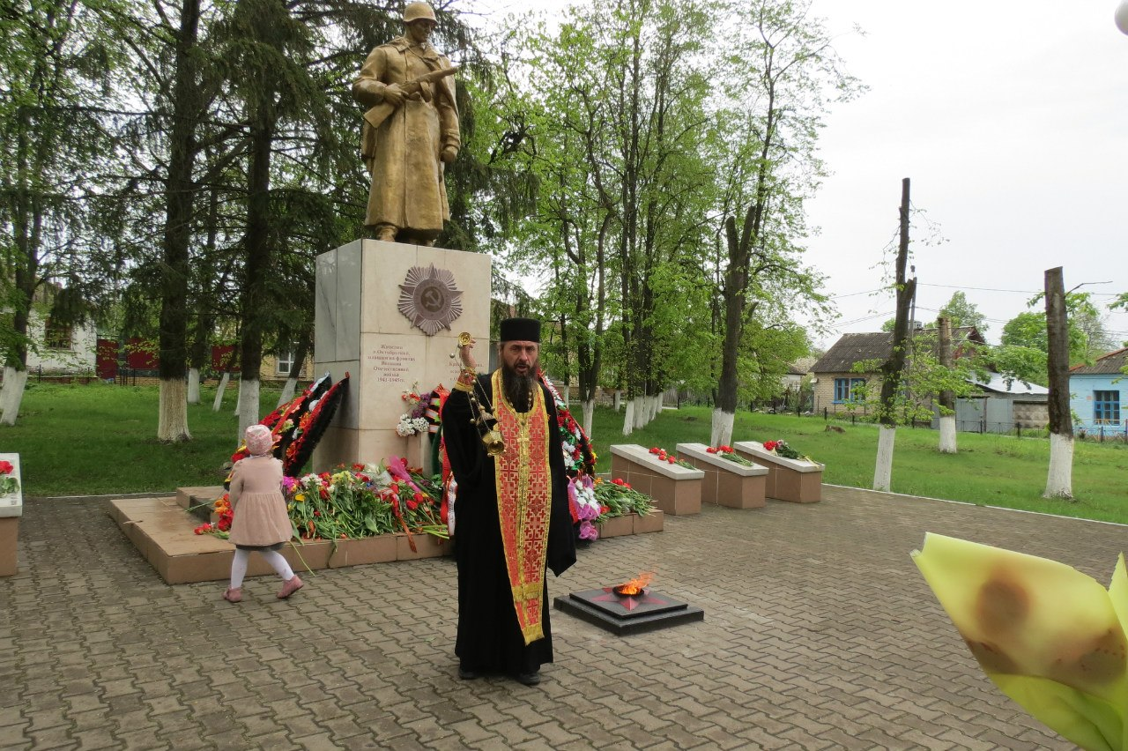
Rituals, which may be called the worship of eternal flame, is at the heart of the cult of Victory.
Today it is not only a civil ceremony. Orthodox clergy regularly takes part in a ceremony at the eternal flame. They are praying for the commemoration of fallen soldiers, but it is noteworthy that they do these prayers at the memorials and not in the churches.

Slide 24
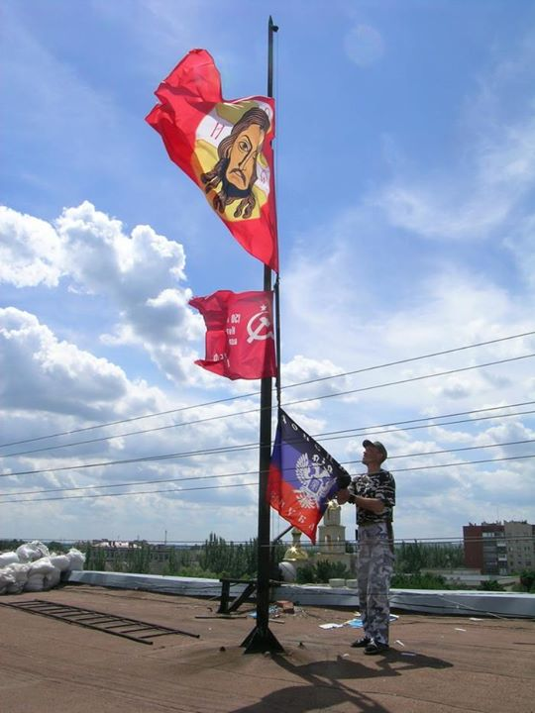
Снято по всей видимости в Донецкой респубилке (ДНР)
Фото из интернета, 2014

Slide 25
